Slide 1
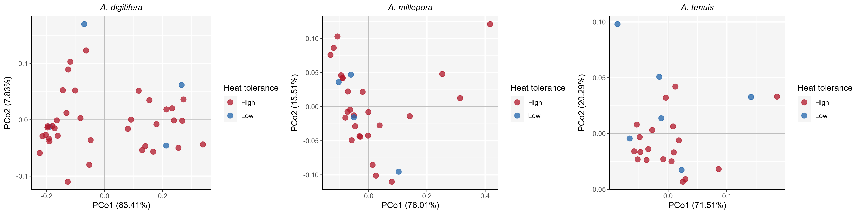
Bray-Curtis dissimilarity, mortality-based
A. digitifera
A. millepora
A. tenuis
PERMANOVA: R² = 0.02535, P = 0.3183
PERMANOVA: R² = 0.01881, P = 0.5944
PERMANOVA: R² = 0.05348, P = 0.2539

Slide 2
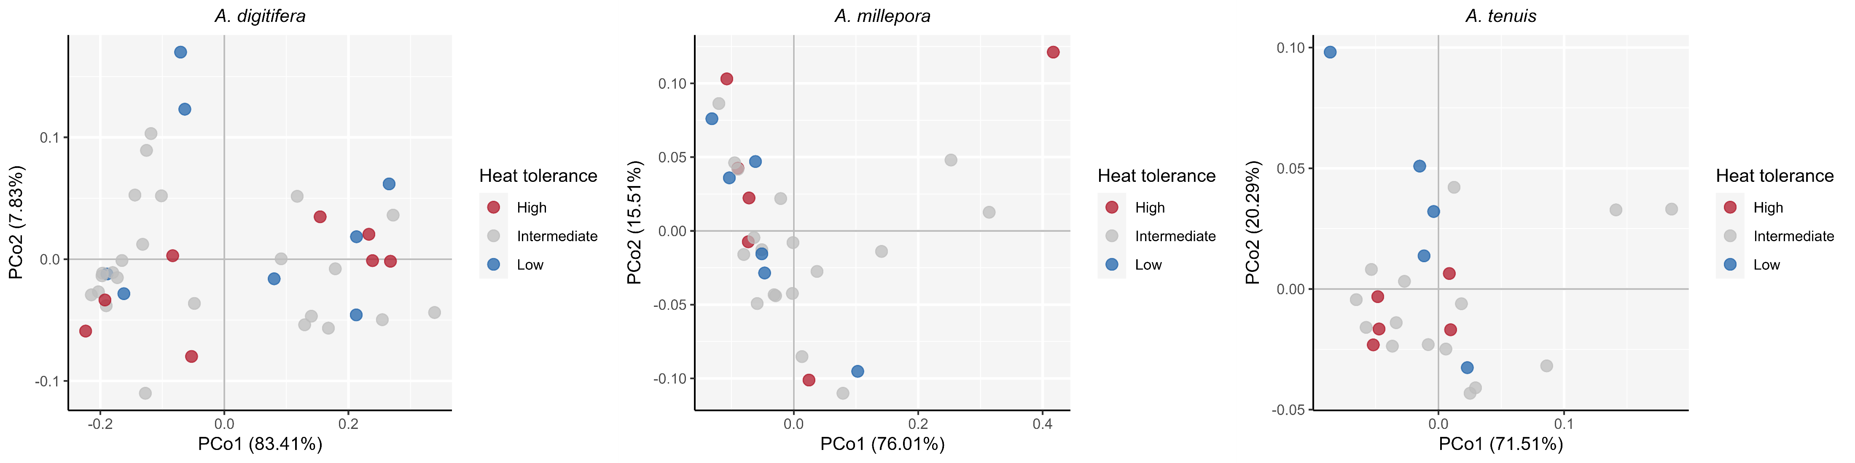
Bray-Curtis dissimilarity, MIG-based
A. digitifera
A. millepora
A. tenuis
PERMANOVA: R² = 0.04101, P = 0.4872
PERMANOVA: R² = 0.04845, P = 0.5858
PERMANOVA: R² = 0.1183, P = 0.2032

Slide 3
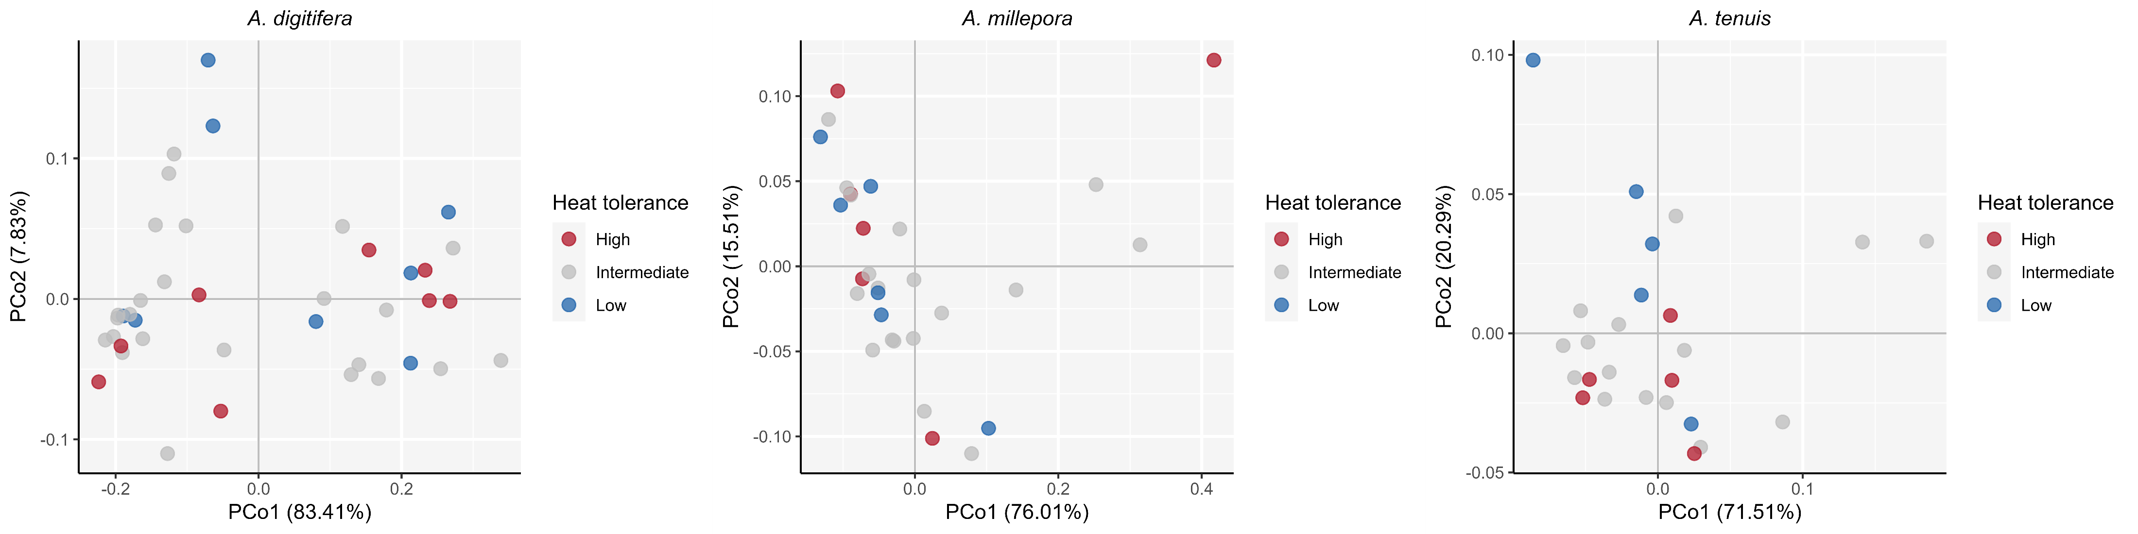
Bray-Curtis dissimilarity, mortality+MIG-based
A. digitifera
A. millepora
A. tenuis
PERMANOVA: R² = 0.04052, P = 0.4892
PERMANOVA: R² = 0.04845, P = 0.5904
PERMANOVA: R² = 0.08624, P = 0.3738

Slide 4

Bray-Curtis dissimilarity, Kmeans-based
A. digitifera
A. millepora
A. tenuis
PERMANOVA: R² = 0.01855, P = 0.4284
PERMANOVA: R² = 0.04911, P = 0.2207
PERMANOVA: R² = 0.05573, P = 0.2347

Slide 5
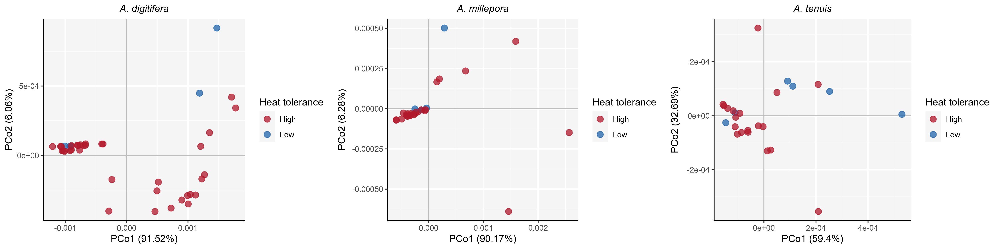
Weighted Unifrac, mortality-based
A. digitifera
A. millepora
A. tenuis
PERMANOVA: R² = 0.01886, P = 0.411
PERMANOVA: R² = 0.01018, P = 0.7705
PERMANOVA: R² = 0.1410, P = 0.0246

Slide 6
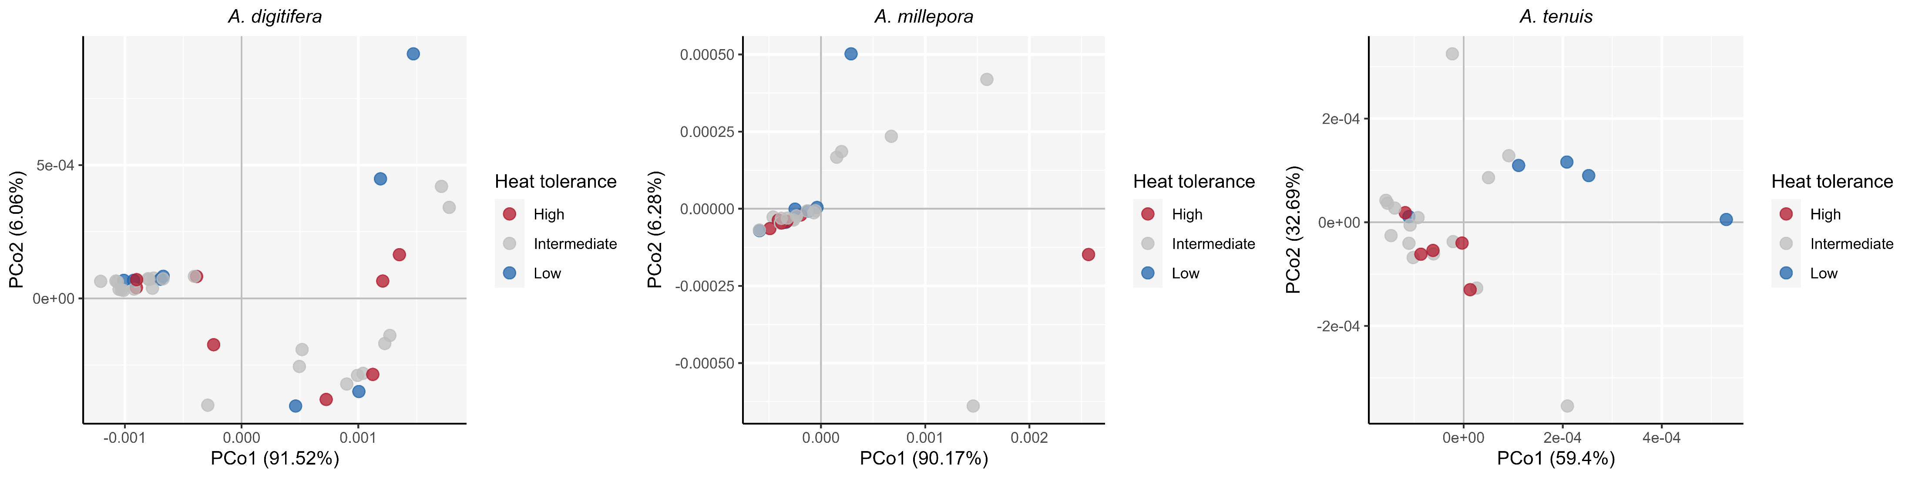
Weighted Unifrac, MIG-based
A. digitifera
A. millepora
A. tenuis
PERMANOVA: R² = 0.02652, P = 0.6325
PERMANOVA: R² = 0.02413, P = 0.8370
PERMANOVA: R² = 0.2602, P = 0.008600

Slide 7
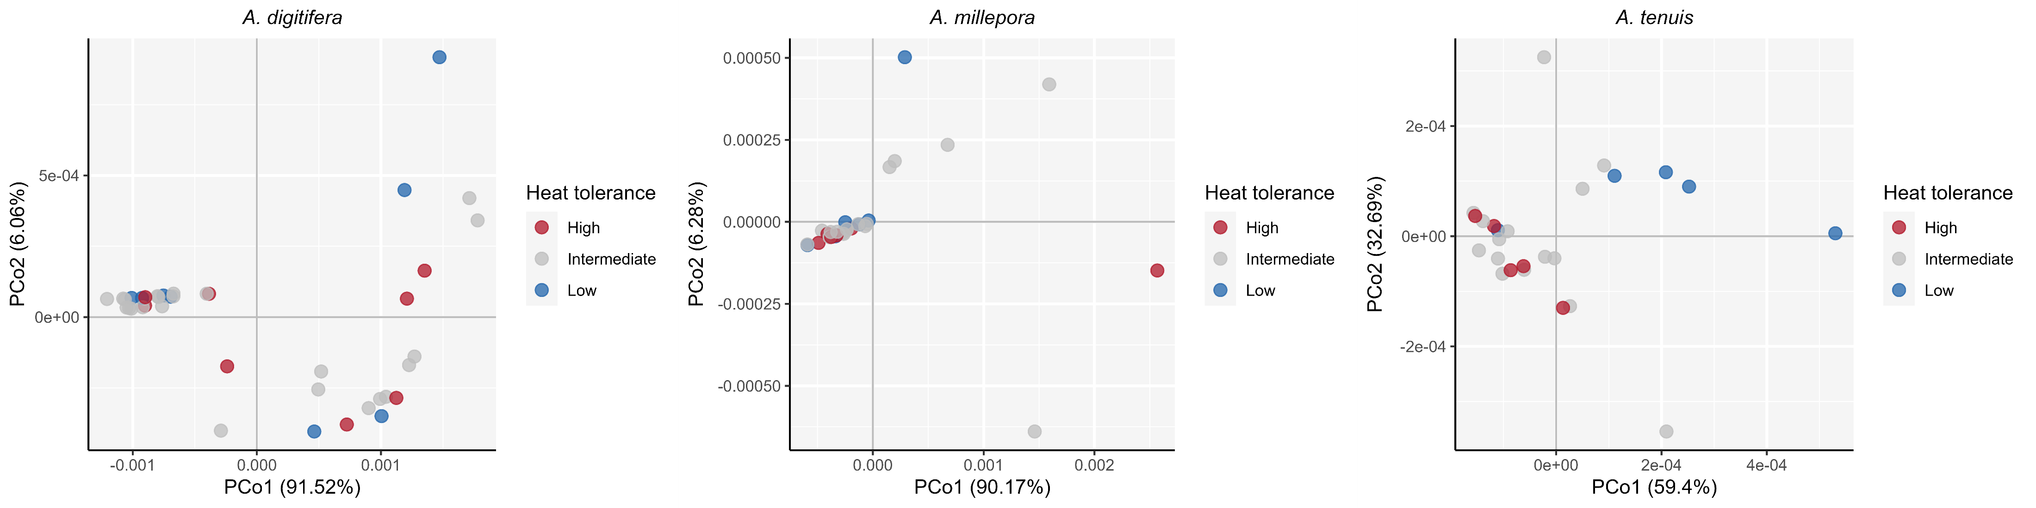
Weighted Unifrac, mortality+MIG-based
A. digitifera
A. millepora
A. tenuis
PERMANOVA: R² = 0.02558, P = 0.6553
PERMANOVA: R² = 0.02413, P = 0.8347
PERMANOVA: R² = 0.2541, P = 0.009300

Slide 8
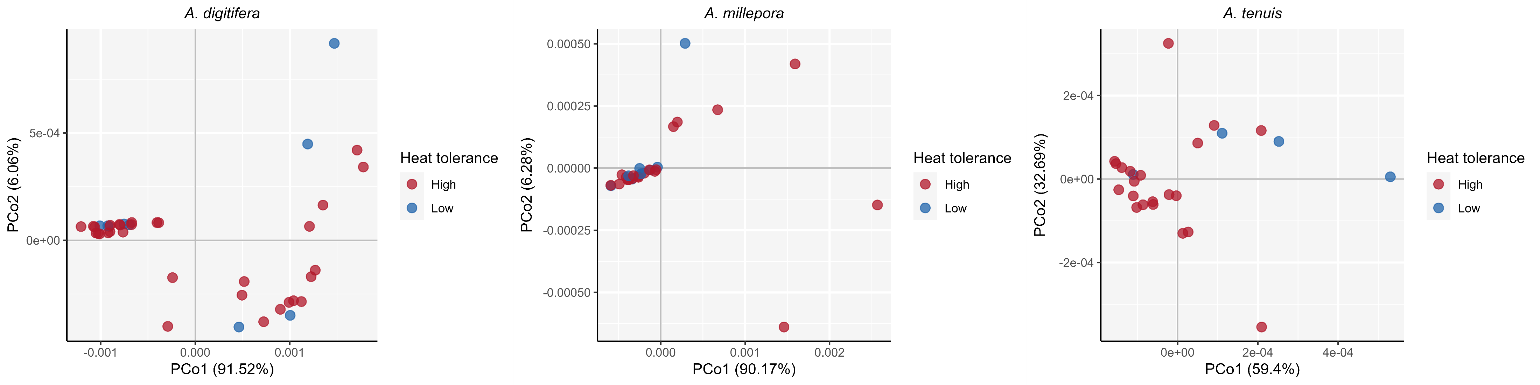
Weighted Unifrac, Kmeans-based
A. digitifera
A. millepora
A. tenuis
PERMANOVA: R² = 0.006763, P = 0.6760
PERMANOVA: R² = 0.03383, P = 0.3611
PERMANOVA: R² = 0.1814, P = 0.01610

Slide 9
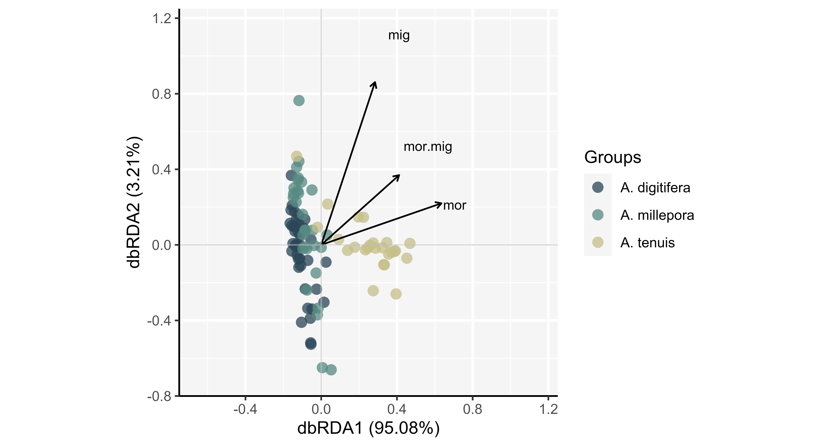
Bray-Curtis dissimilarity, dbRDA
PERMANOVA: R² = 0.2207, P = 0.001
A. digitifera
A. millepora
A. tenuis

Slide 10
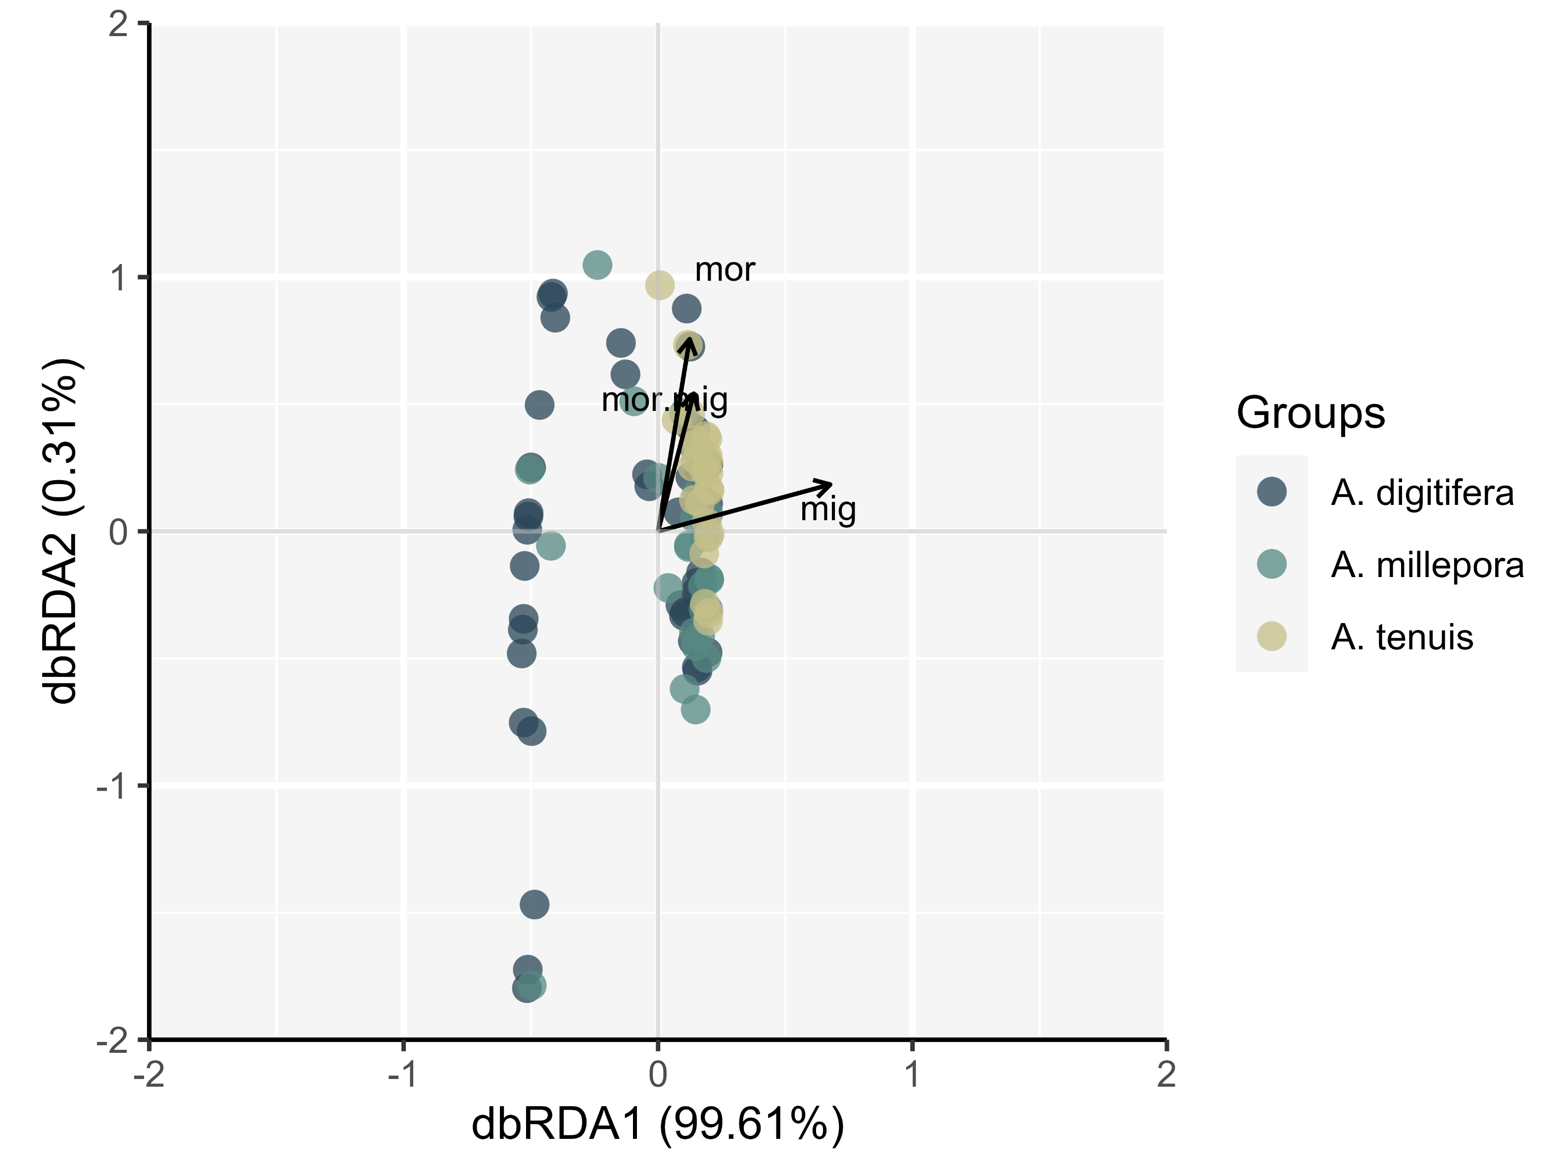
Weighted Unifrac, dbRDA
PERMANOVA: R² = 0.2312, P = 0.001
A. digitifera
A. millepora
A. tenuis

